Slide 1
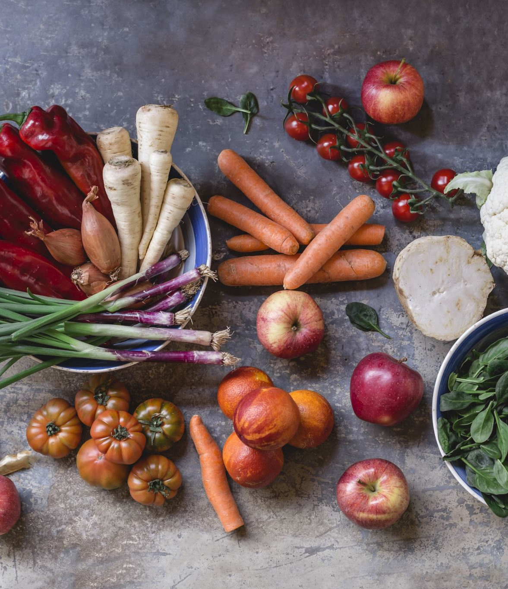
Sustainable Foods
Oz, Luke, Cerys & Laura

Slide 2
Elevator Pitch
We are working towards elevating students' knowledge around sustainable food.
GoodGrapes’ goal is to educate students on sustainability when it comes to food, to help assist their desired lifestyles. Therefore, our key focus is to create an app aimed at university students who are wanting to better their eating lifestyle.
The main benefit of this is having key knowledge of sustainability in the pocket of our users at any time.
As opposed to other companies such as Good Fish Guide we offer an accessible app with an offline database that helps detect sustainability within foods. From using the app students will be able to immediately know the sustainability of products.

Slide 3

User Research
Primary
24 Students aged between 18-25 were interviewed. 8 were observed
Secondary
Looking at other people's matrices, note down key insights and why we looked at them, websites too.
24 Students aged between 18-25 were interviewed, 8 were observed.
How does sustainability influence their daily lives?

Slide 4
Key Points
Time Constraints
Affordability
Lack of Motivation

Slide 5

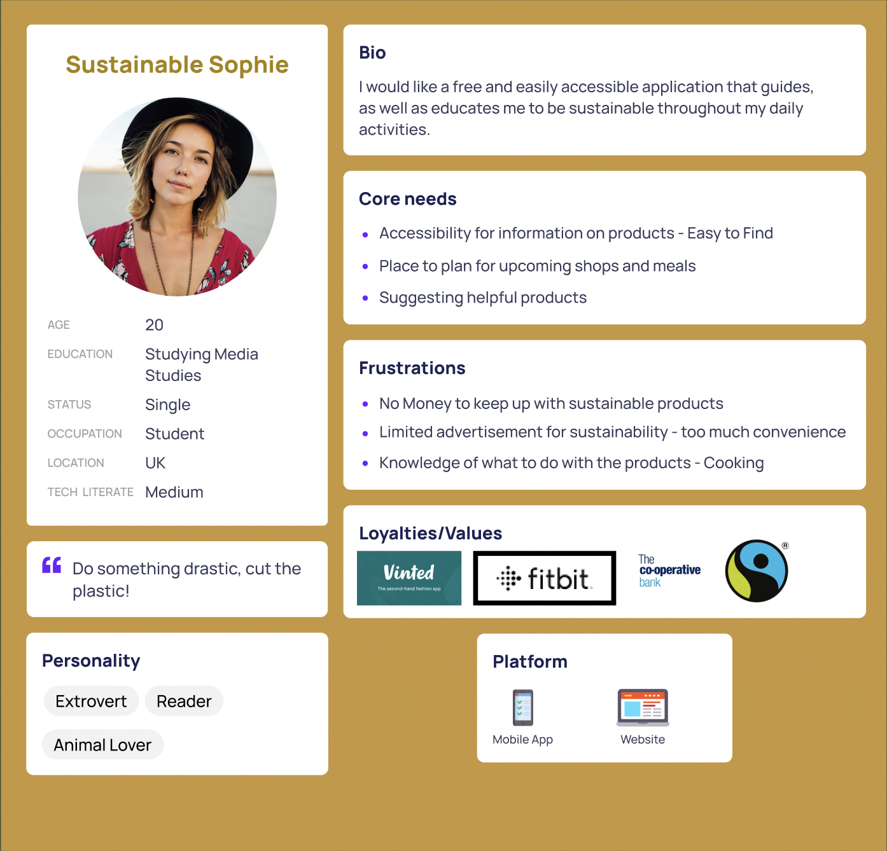
Persona 1

Slide 6

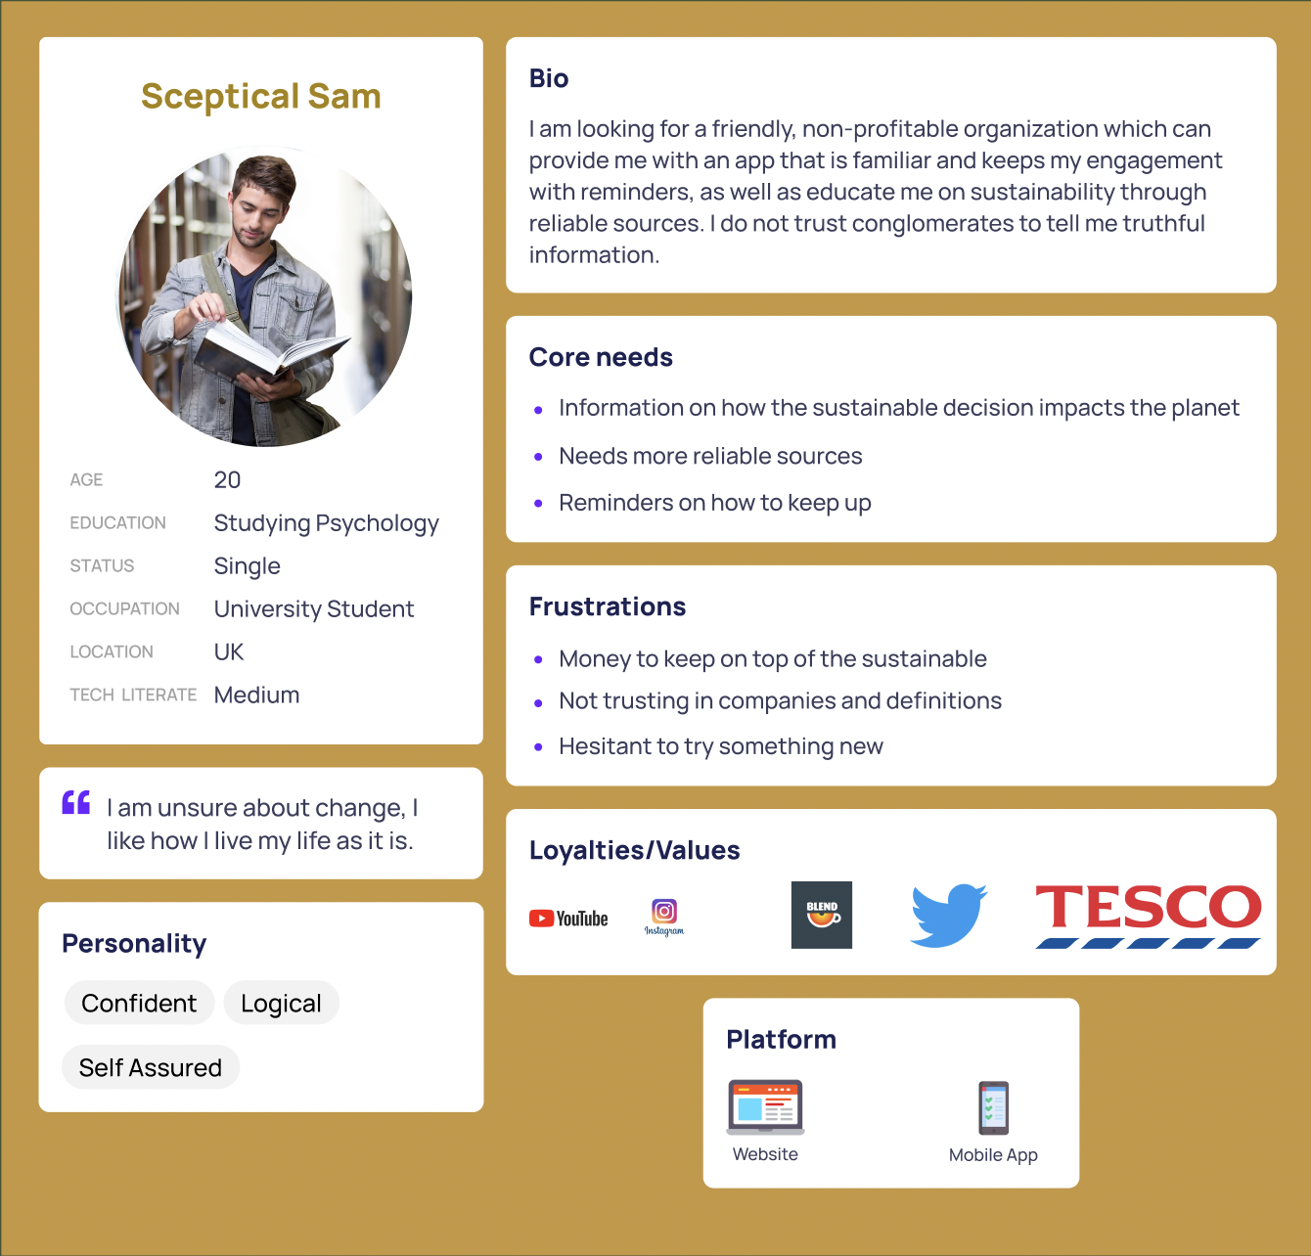
Perso

Slide 7

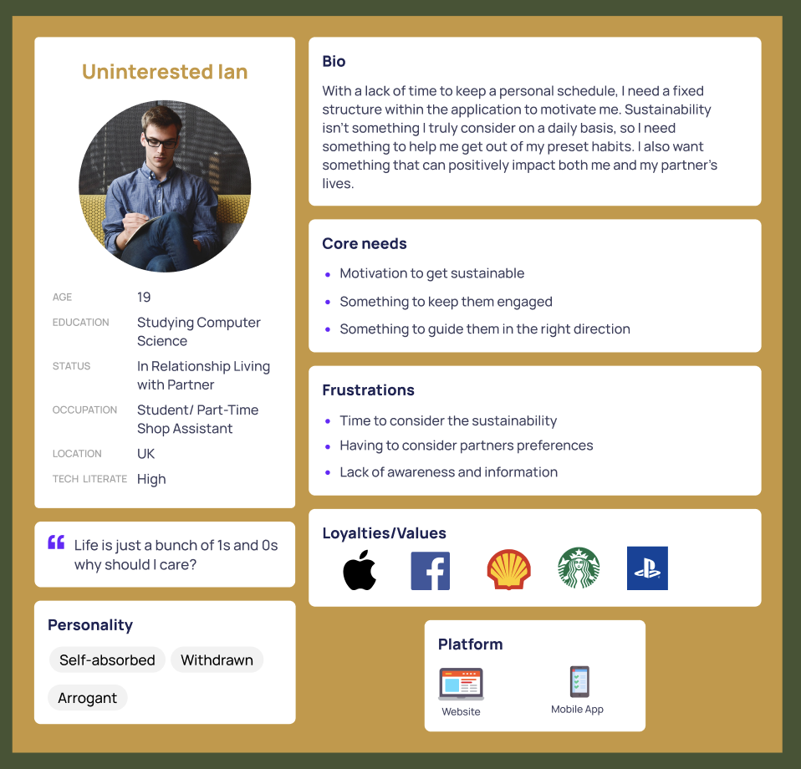
Perso

Slide 8
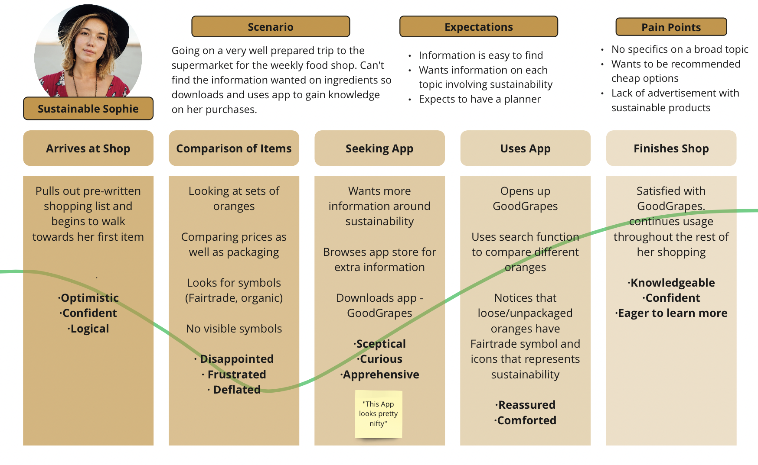

Slide 9
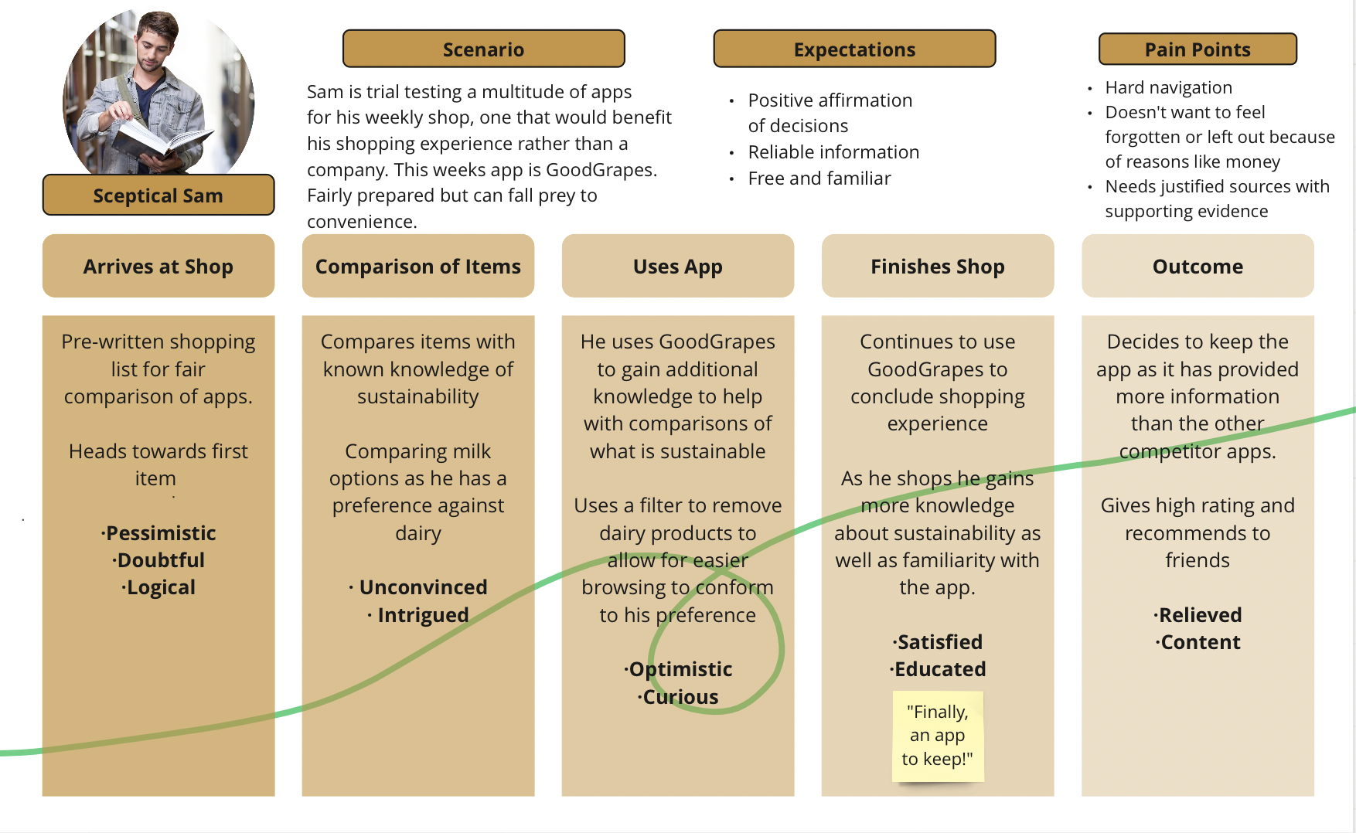

Slide 10
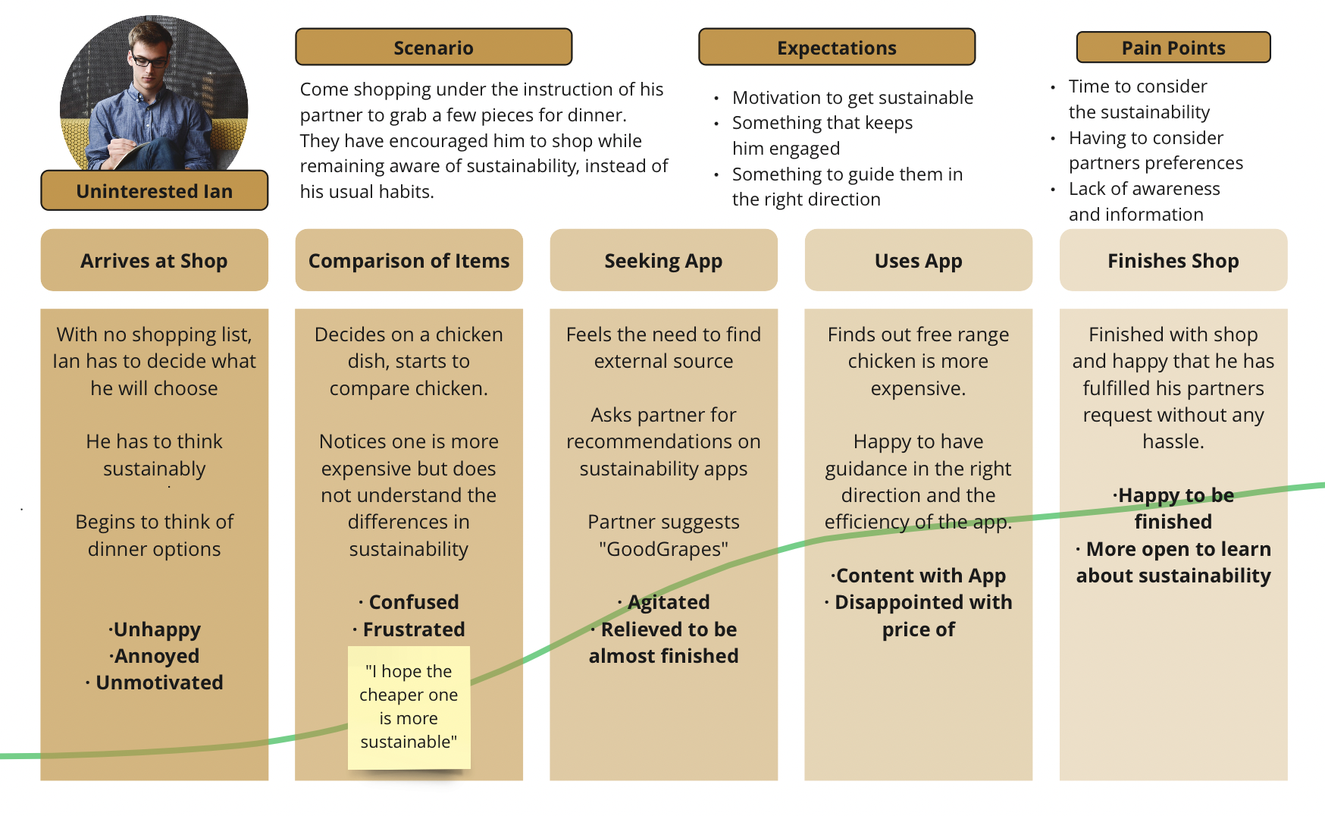

Slide 11
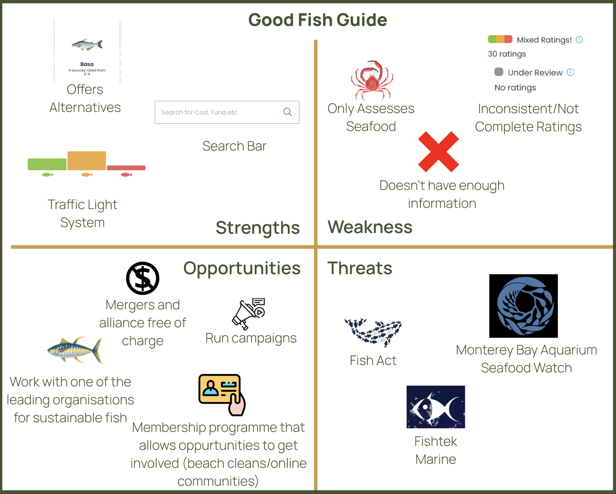
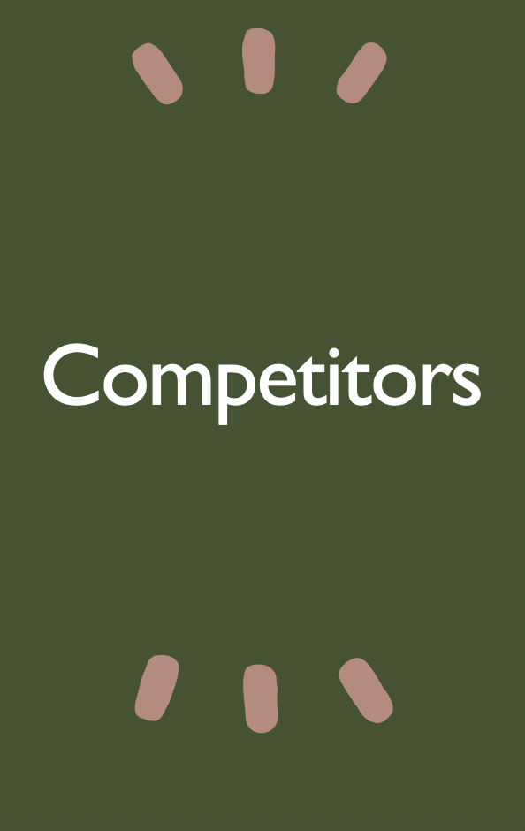

Slide 12

Design Requirements
Traffic light system
Offline System
Badges
Reward System

Slide 13
References
‌Belogianni, K., Ooms, A., Lykou, A. and Moir, H.J. (2021) Nutrition knowledge among university students in the UK: a cross-sectional study. Public Health Nutrition. [online]. 25 (10), pp.1–8. [Accessed 25 October 2022]
‌BMC (2018) Dietary patterns of university students in the UK: a cross-sectional study. Available from: https://nutritionj.biomedcentral.com/articles/10.1186/s12937- 018-0398-y [Accessed 22 October 2022].
Finger, F. (2023) 2.7 million+ Stunning Free Images to Use Anywhere - Pixabay - Pixabay Pixabay.com.2023 [online]. Available from: https://pixabay.com/ [Accessed 1 March 2023].
‘Good Fish Guide’ (2023) Mcsuk.org.2023 [online]. Good Fish Guide. Available from: https://www.mcsuk.org/goodfishguide/ [Accessed 1 March 2023].
‌Lewis, A. (2021) Sustainable Food Practices: Choices & Importance The Hub | High Speed Training.25 June 2021 [online]. The Hub | High Speed Training. Available from: https://www.highspeedtraining.co.uk/hub/what-is-food-sustainability/ [Accessed 1 March 2023].
‌Sogari, G., Velez-Argumedo, C., Gómez, M. and Mora, C. (2018) College Students and Eating Habits: A Study Using An Ecological Model for Healthy Behavior. Nutrients. [online]. 10 (12), p.1823. Available from: https://www.ncbi.nlm.nih.gov/pmc/articles/PMC6315356/ [Accessed 1 March 2023].
‌‘WebAIM: Contrast Checker’ (2023) Webaim.org.2023 [online]. Available from: https://webaim.org/resources/contrastchecker/ [Accessed 1 March 2023].
‌‘What Does Food Sustainability Really Mean?’ (2017) Eco & Beyond.30 January 2017 [online]. Available from: https://www.ecoandbeyond.co/articles/food-sustainability/ [Accessed 1 March 2023].

